Slide 1
House Prices Prediction
Shasha Li 861306114
Tu Nguyen 861309226

Slide 2
1
Problem Definition
4
Conclusion
Roadmap
2
3
Our Methods
Related Works

Slide 3
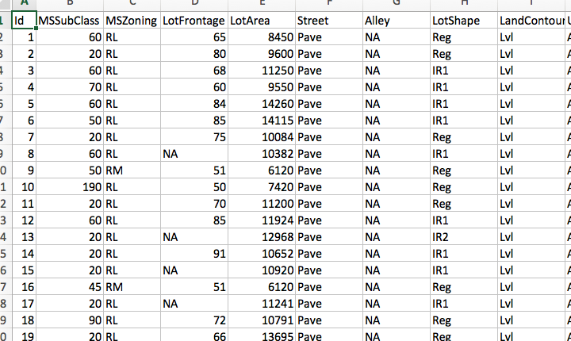
1.Problem Definition
Given Ames Housing dataset with 79 attributes
How to predict the house prices accurately?
Evaluation method: Root Mean Squared Error (RMSE)

Slide 4
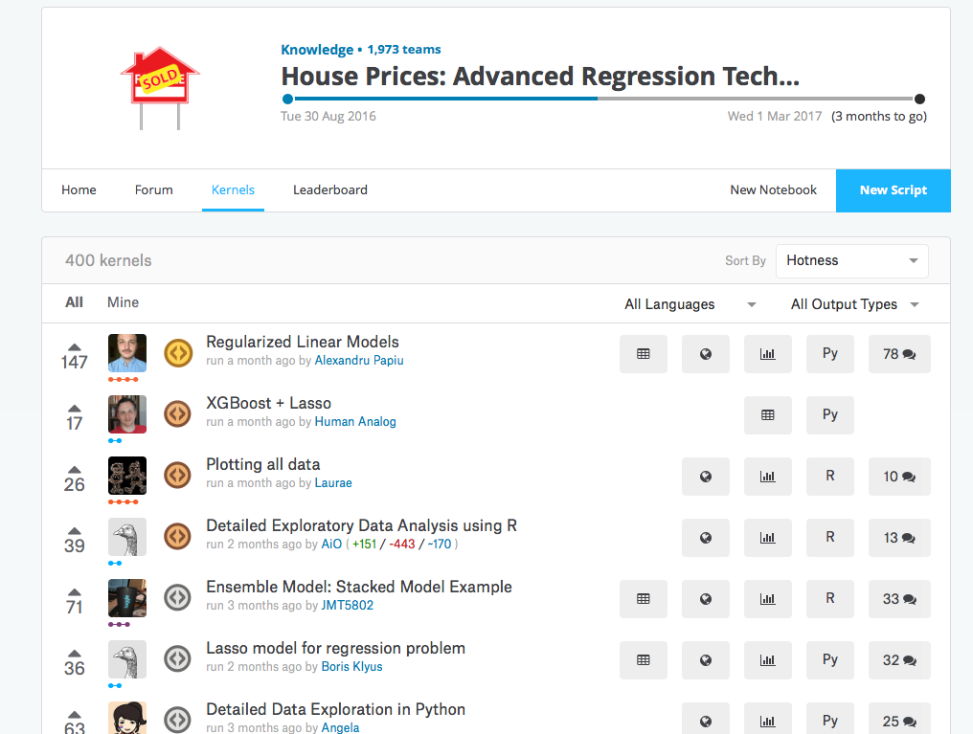
2. Related Works
Data exploration
Ridge, Lasso, Random Forest, XGBoost.
Ensemble

Slide 5
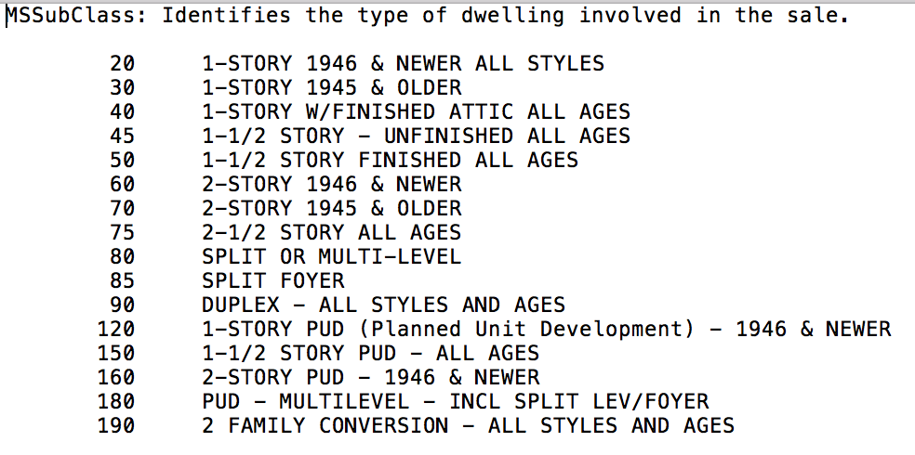
3. Proposed Methods 3.1 Feature Engineering
Convert data type of features:
MSSubClass from numeric to string
Convert categorical values to dummy values

Slide 6
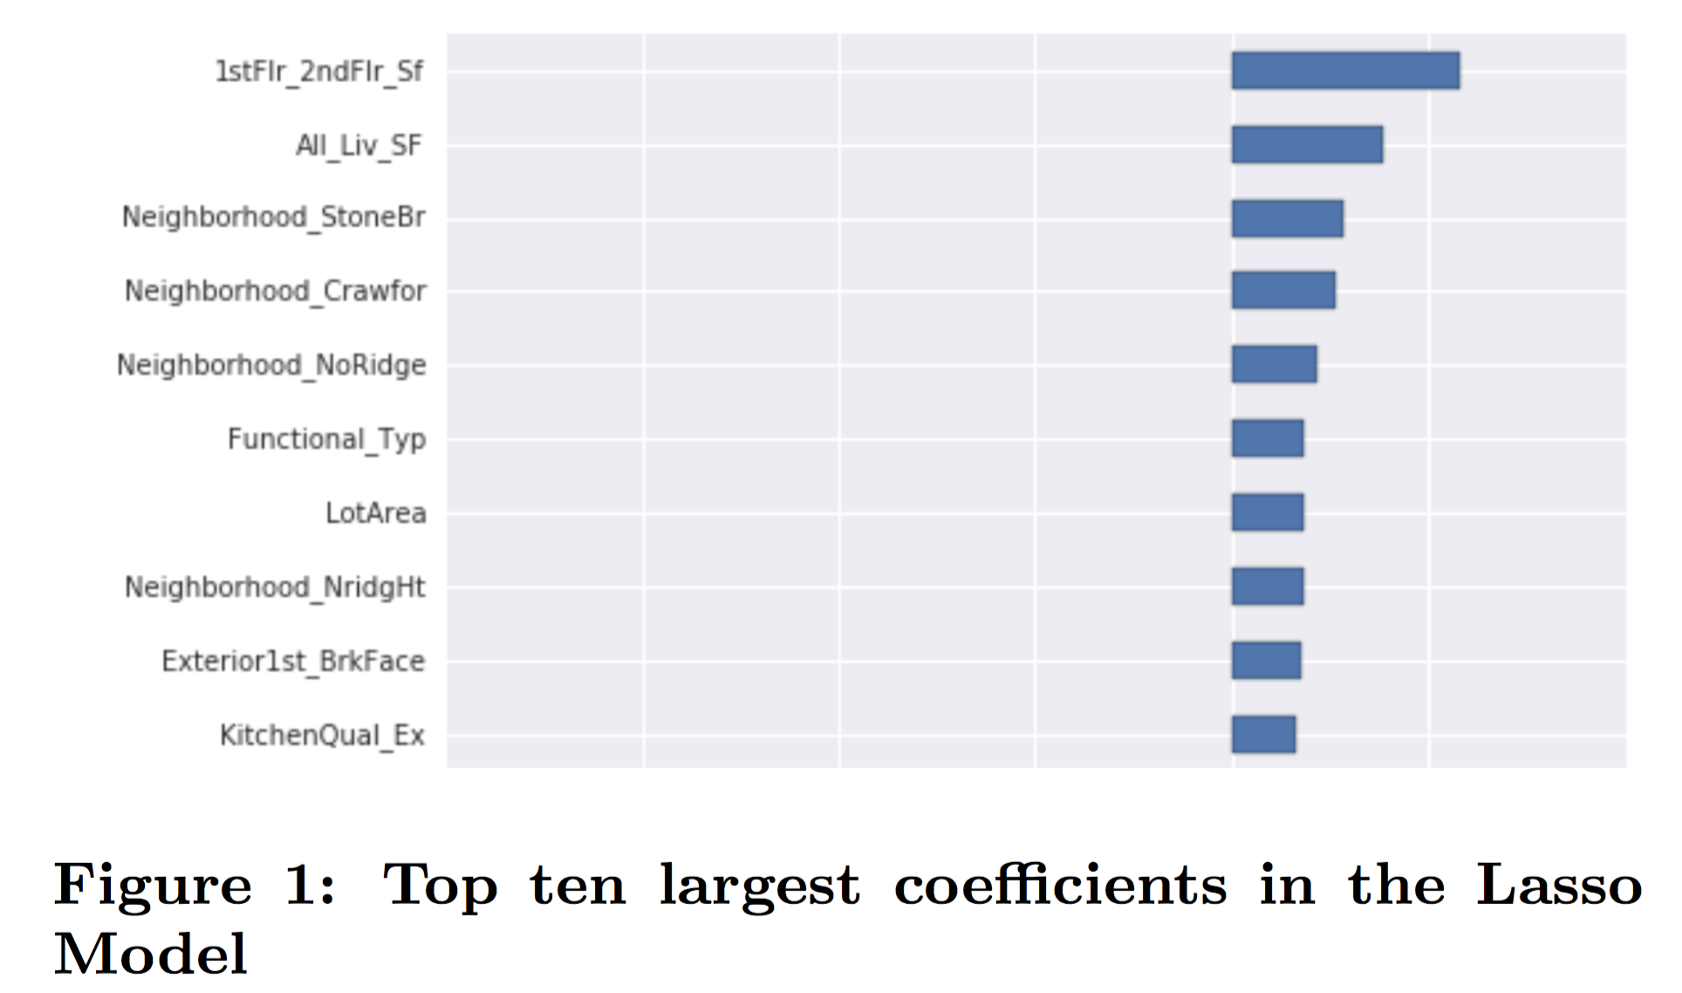
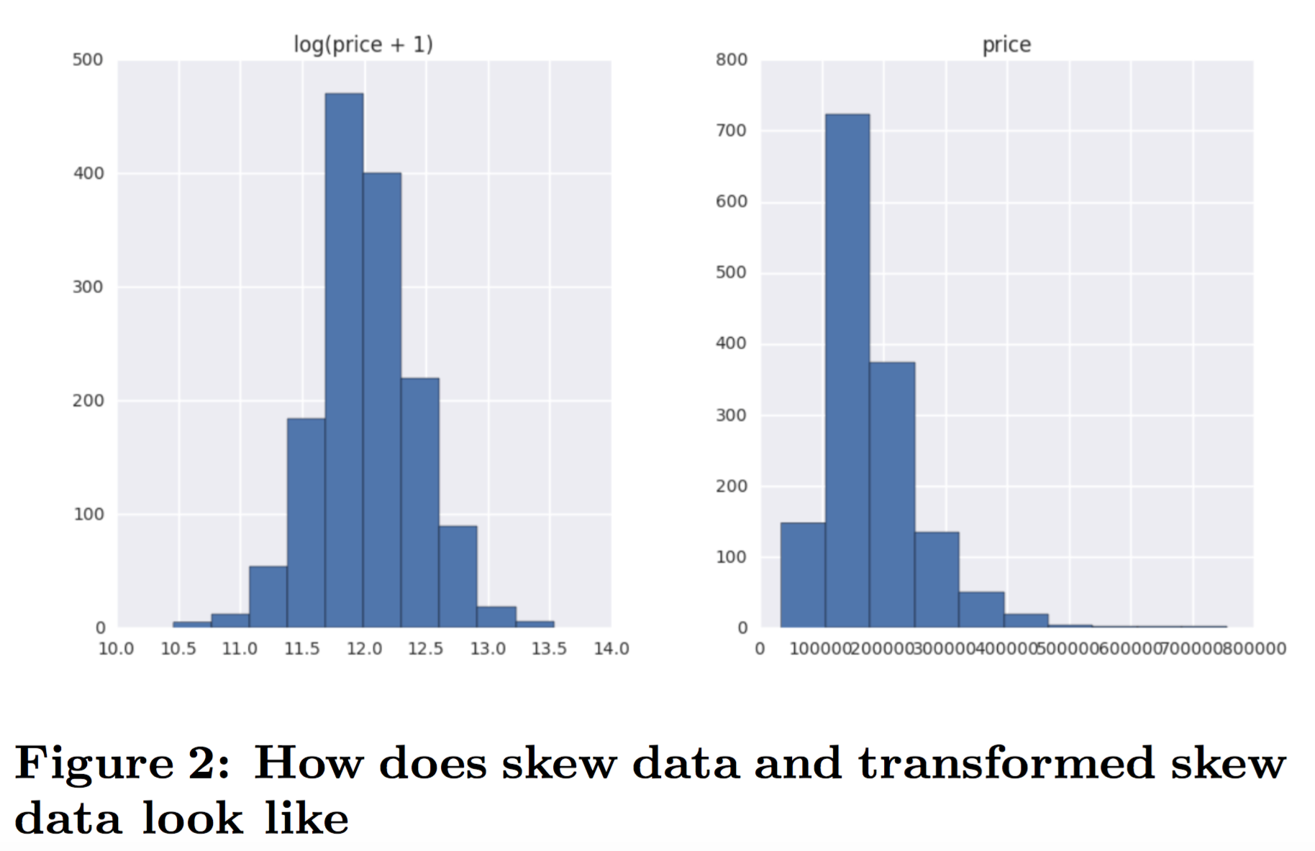
3. Proposed Methods 3.1 Feature Engineering
Create new features
1stFlr_2ndFlr_Sf from 1stFlrSF and 2ndFlrSF
All_Liv_SF from 1stFlrSF, 2ndFlrSF, LowQualFinSF, and GrLivArea
Calculate the skewness of every numeric feature
Do log-transformation for those
whose skewness ≥ 0.75.

Slide 7
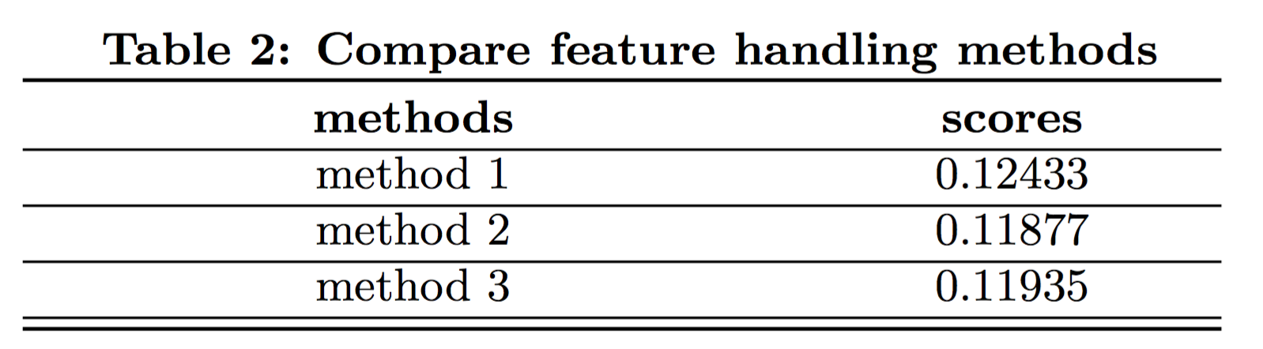
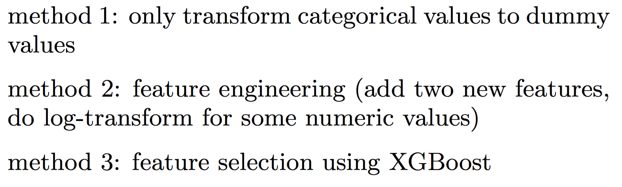
3. Proposed Methods 3.1 Feature Engineering
Results
improve the rank from 670 to 248

Slide 8
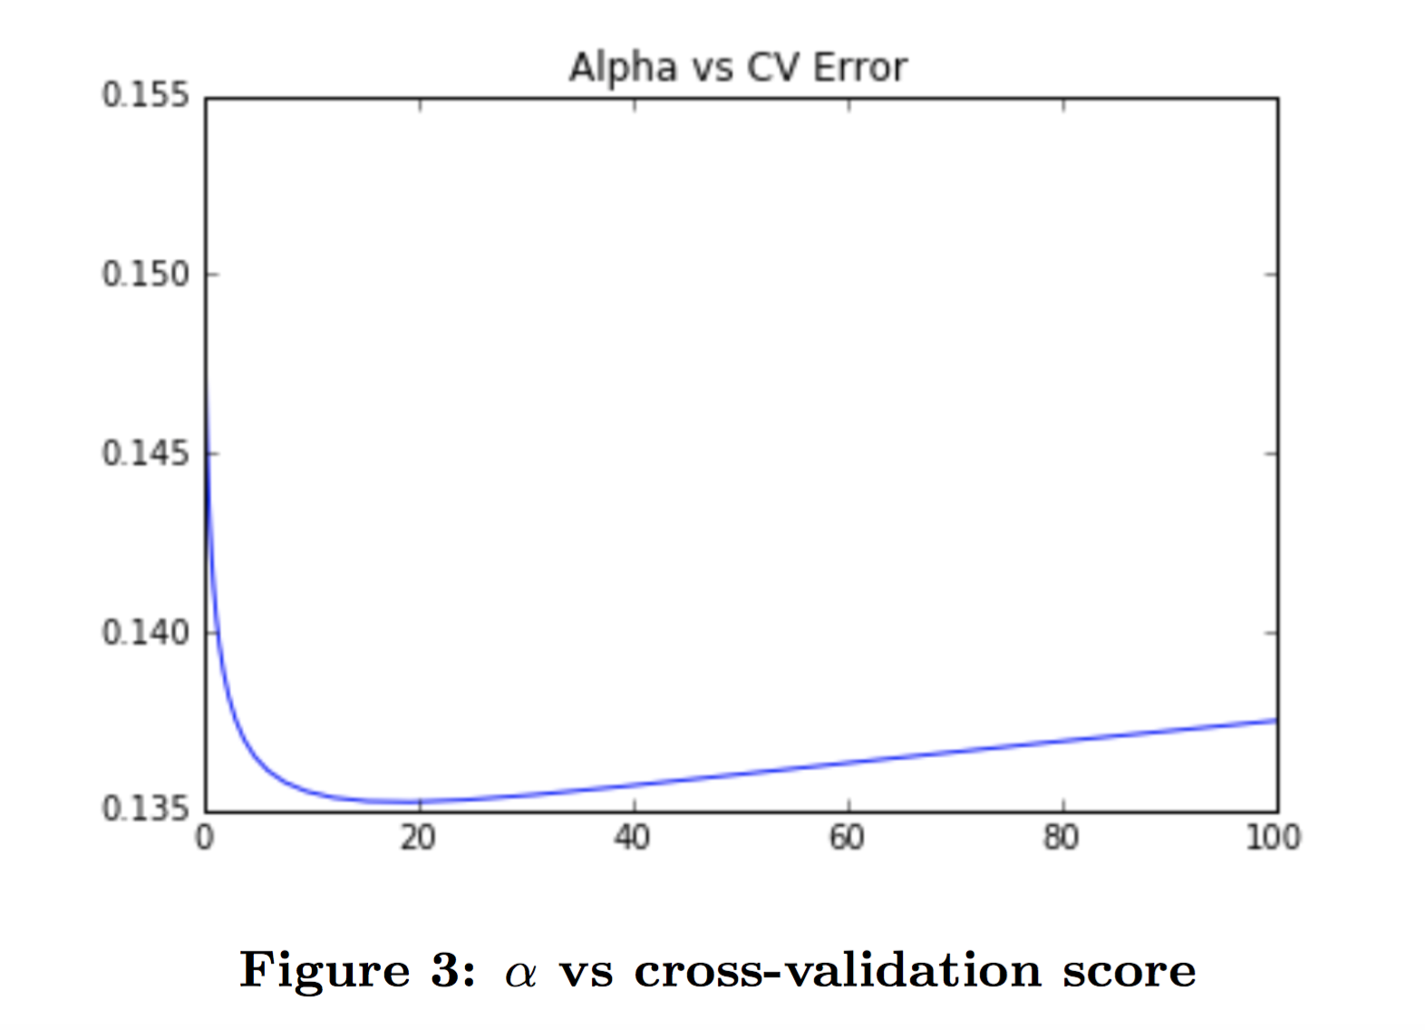
3. Proposed Methods 3.2 Prediction Models
Ridge
Regularized linear regression
Test 50 different values from 10⁻³ to 10² and use α=19.3069772888
Lasso
Regularized linear regression
Test 50 different values from 10⁻⁵ to 1 and finally use α =1.26485521686e-05.

Slide 9
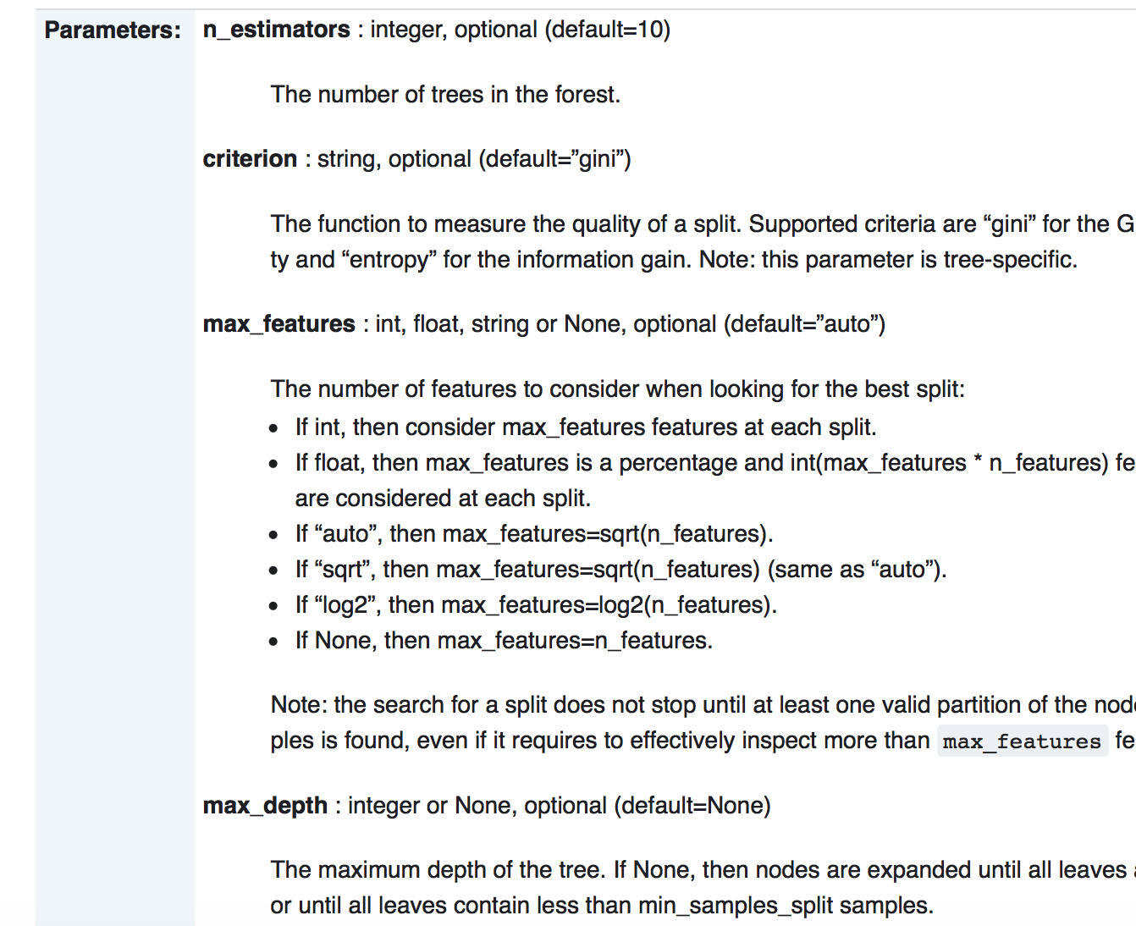
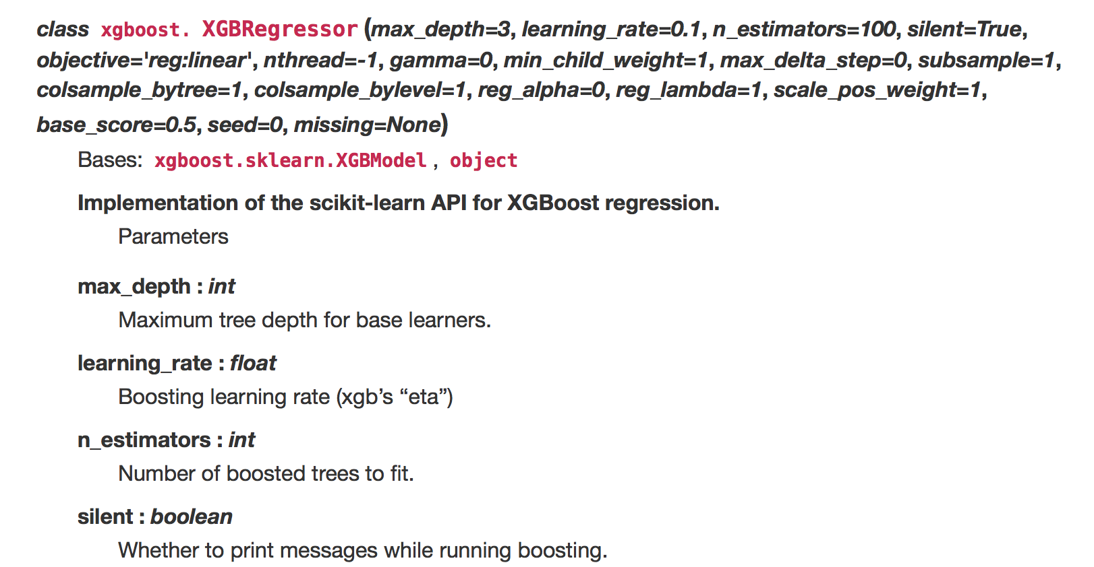
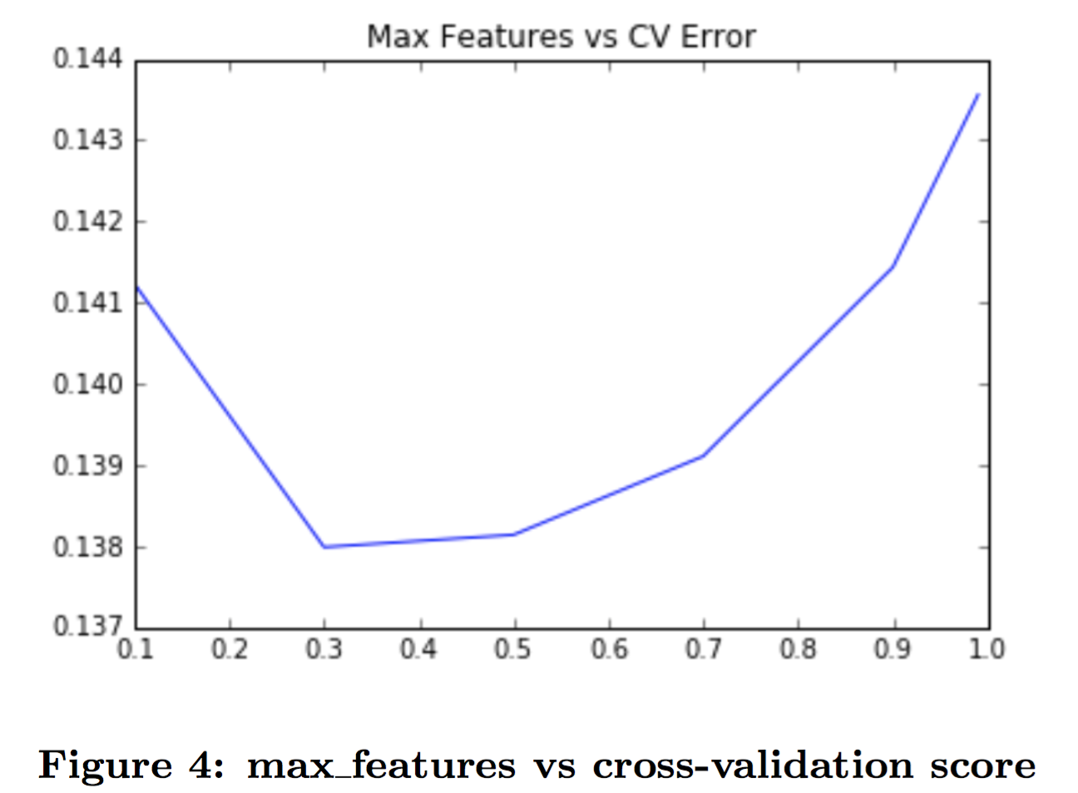
3. Proposed Methods 3.2 Prediction Models
Random Forest
Ensemble Method
Collection of decision trees
XGBoost
Ensemble method
Parallel tree boosting (gradient boosting)

Slide 10
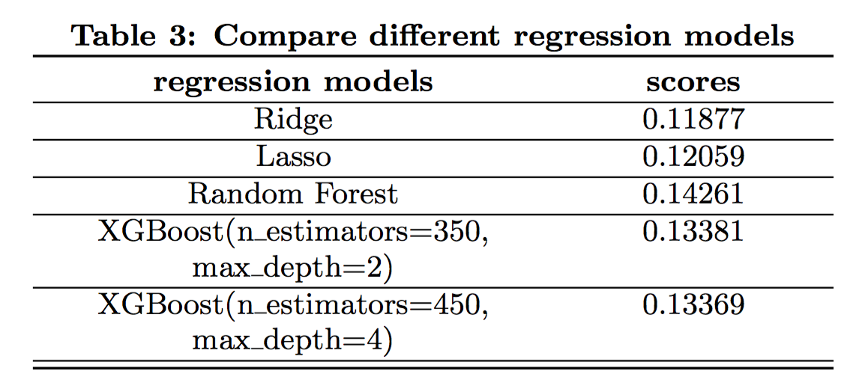
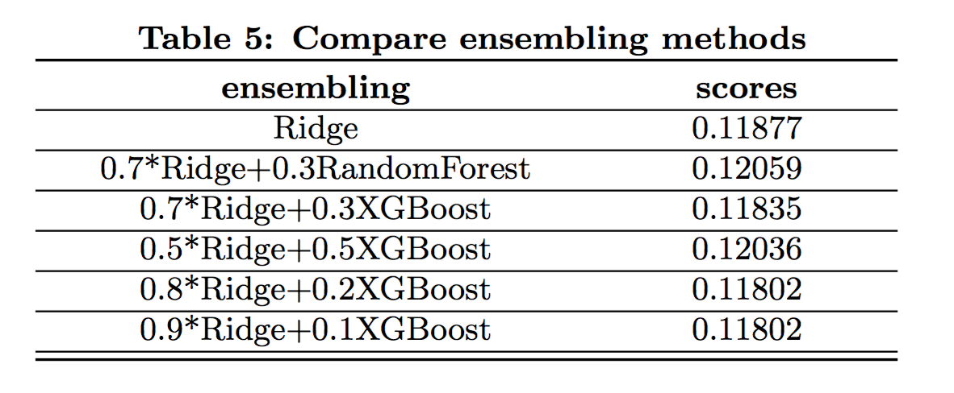
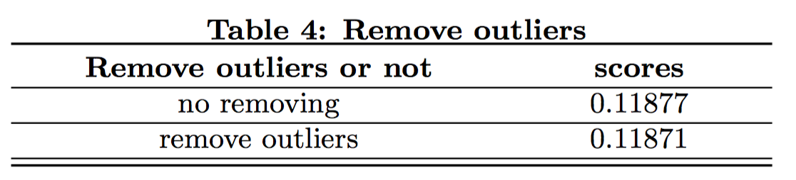
3. Proposed Methods 3.2 Prediction Models
Results
Combining different models can gain better results
Remove outliers improve the performance

Slide 11
4. Conclusion
original score 0.1316 (rank 839),
eventually achieve 0.11802 (rank 206, top 10.2%).
Two directions to improve performance
Feature engineering is extremely important.
More feature engineering
look closer into features and maybe consult some domain experts
Ensemble is pretty powerful.
Ensemble
stack and blend existing models
Detect and remove outliers

